Slide 1
Big Data Analytics: LAB04
Younghoon Kim
(nongaussian@hanyang.ac.kr)

Slide 2
Problem 1
Given
Four attributes and one class
Training data (12 instances)
Data is at HY-in
Test data (2 instances)
Data is at HY-in
Find
Find class of test data set using navie bayes

Slide 3
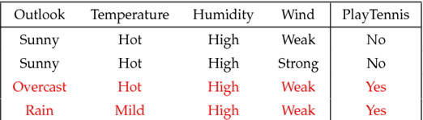
Problem 1 data types
Given
Attributes(name {value})
Outlook {Sunny,Overcast,Rain}
Temperature {Hot,Mild,Cool}
Humidity {High,Normal}
Wind {Weak,Strong}
Class
PlayTennis {Yes,No}
Delimiter is comma(,)

Slide 4
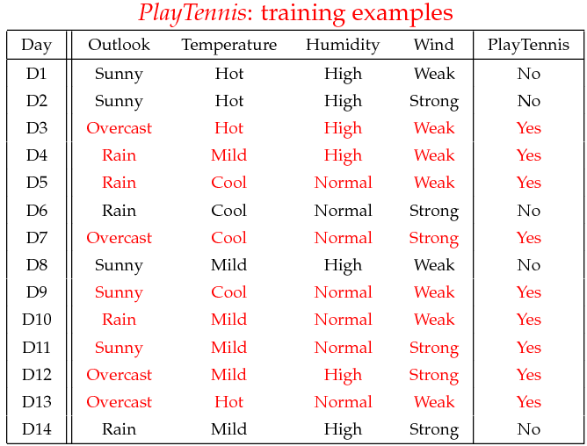
Play-tennis Example
Example: Play Tennis

Slide 5
Play-tennis Example: Estimating P(x_{i}|C)
outlook
P(sunny|p) = 2/9
P(sunny|n) = 3/5
P(overcast|p) = 4/9
P(overcast|n) = 0
P(rain|p) = 3/9
P(rain|n) = 2/5
temperature
P(hot|p) = 2/9
P(hot|n) = 2/5
P(mild|p) = 4/9
P(mild|n) = 2/5
P(cool|p) = 3/9
P(cool|n) = 1/5
humidity
P(high|p) = 3/9
P(high|n) = 4/5
P(p) = 9/14
P(normal|p) = 6/9
P(normal|n) = 2/5
P(n) = 5/14
windy
P(true|p) = 3/9
P(true|n) = 3/5
P(false|p) = 6/9
P(false|n) = 2/5
[George Kollios (Boston Univ)’s slide]

Slide 6
Naive Bayesian Classifier (II)
Given a training set, we can compute the probabilities
[George Kollios (Boston Univ)’s slide]

Slide 7
Play-tennis Example: Classifying X
An unseen sample X = <rain, hot, high, false>
P(X|p)·P(p) = P(rain|p)·P(hot|p)·P(high|p)·P(false|p)·P(p) = 3/9·2/9·3/9·6/9·9/14 = 0.010582
P(X|n)·P(n) = P(rain|n)·P(hot|n)·P(high|n)·P(false|n)·P(n) = 2/5·2/5·4/5·2/5·5/14 = 0.018286
Sample X is classified in class n (don’t play)
[George Kollios (Boston Univ)’s slide]

Slide 8
Problem 2
Given
Four attributes and one class
Training data (1634 instances)
Data is at HY-in
Test data (94 instances)
Data is at HY-in
Find
Find class of test data set using navie bayes

Slide 9
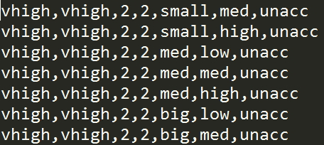
Problem 2 data types
Given
Attributes(name {value})
Buying {vhigh,high,med,low}
Maintenance {vhigh,high,med,low}
Doors {2,3,4,5more}
Persons {2,4,more}
Size of luggage boot {small,med,big}
Safety {low,med,high}
Class
Acceptability {unacc,acc,vgood,good}
Delimiter is comma(,)
Attributes
Class

